Slide 1

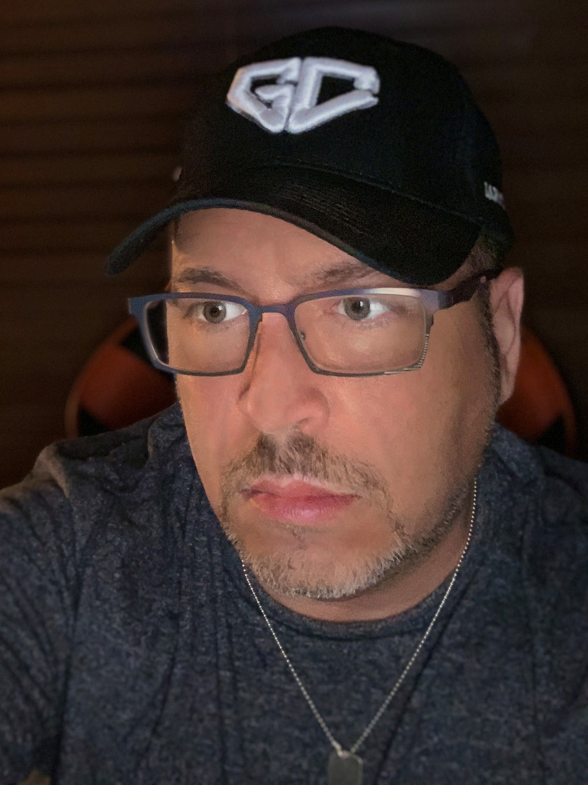



CREATIVE MARKETER
FOR HIRE
J. Andrew de Leon

Slide 2
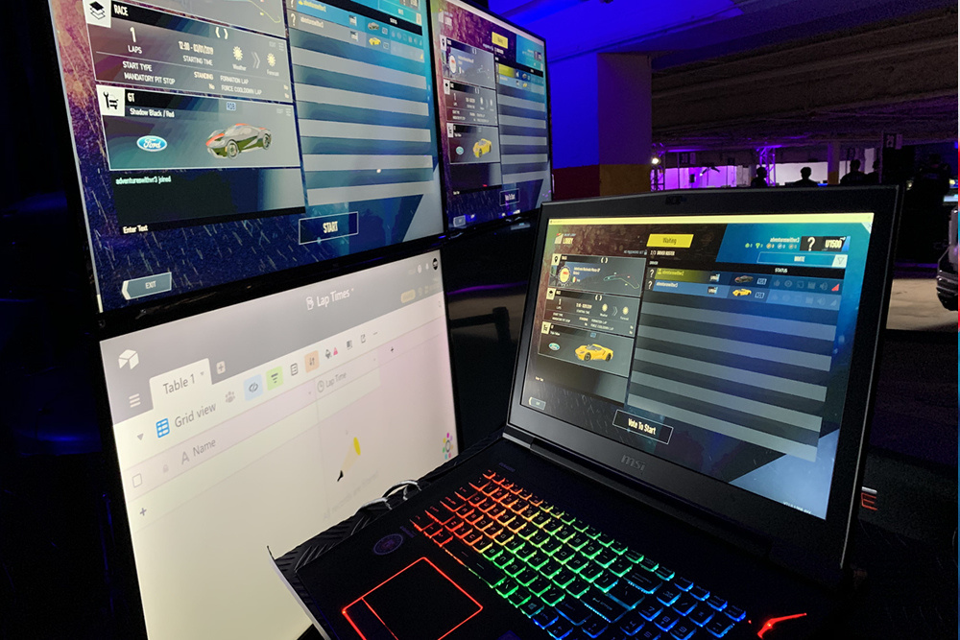


Companies
Lifetime of Experience
I have been the owner and CEO of Jade Marketing & Technology Corporation since 1997 as well as its subsidiaries, Adventures with VR and the Vector VR Sim Racing Experience since 2015.
Jade Marketing is a Minnesota based marketing agency providing a wide variety of marketing and creative services while AVR and VectoR were established to provide the best in virtual reality event and experiential marketing services.
J. Andrew de Leon
Owner | CEO

Slide 3







Areas of Expertise
With over 30 years of hands-on experience in all aspects and disciplines of marketing, I have additionally acquired skill sets in creative design, branding, rebranding, web development, SEO | SEM, media, production, augmented and virtual reality as well as strategic business solutions. I possess a deep working knowledge and the ability to perform in each one of these categories.
J. Andrew de Leon
Creative Marketer
Marketing
Branding
Creative
Design
Event Management
WordPress
Development SEO, SEM
Media and
Production
Training and Team Management

Slide 4
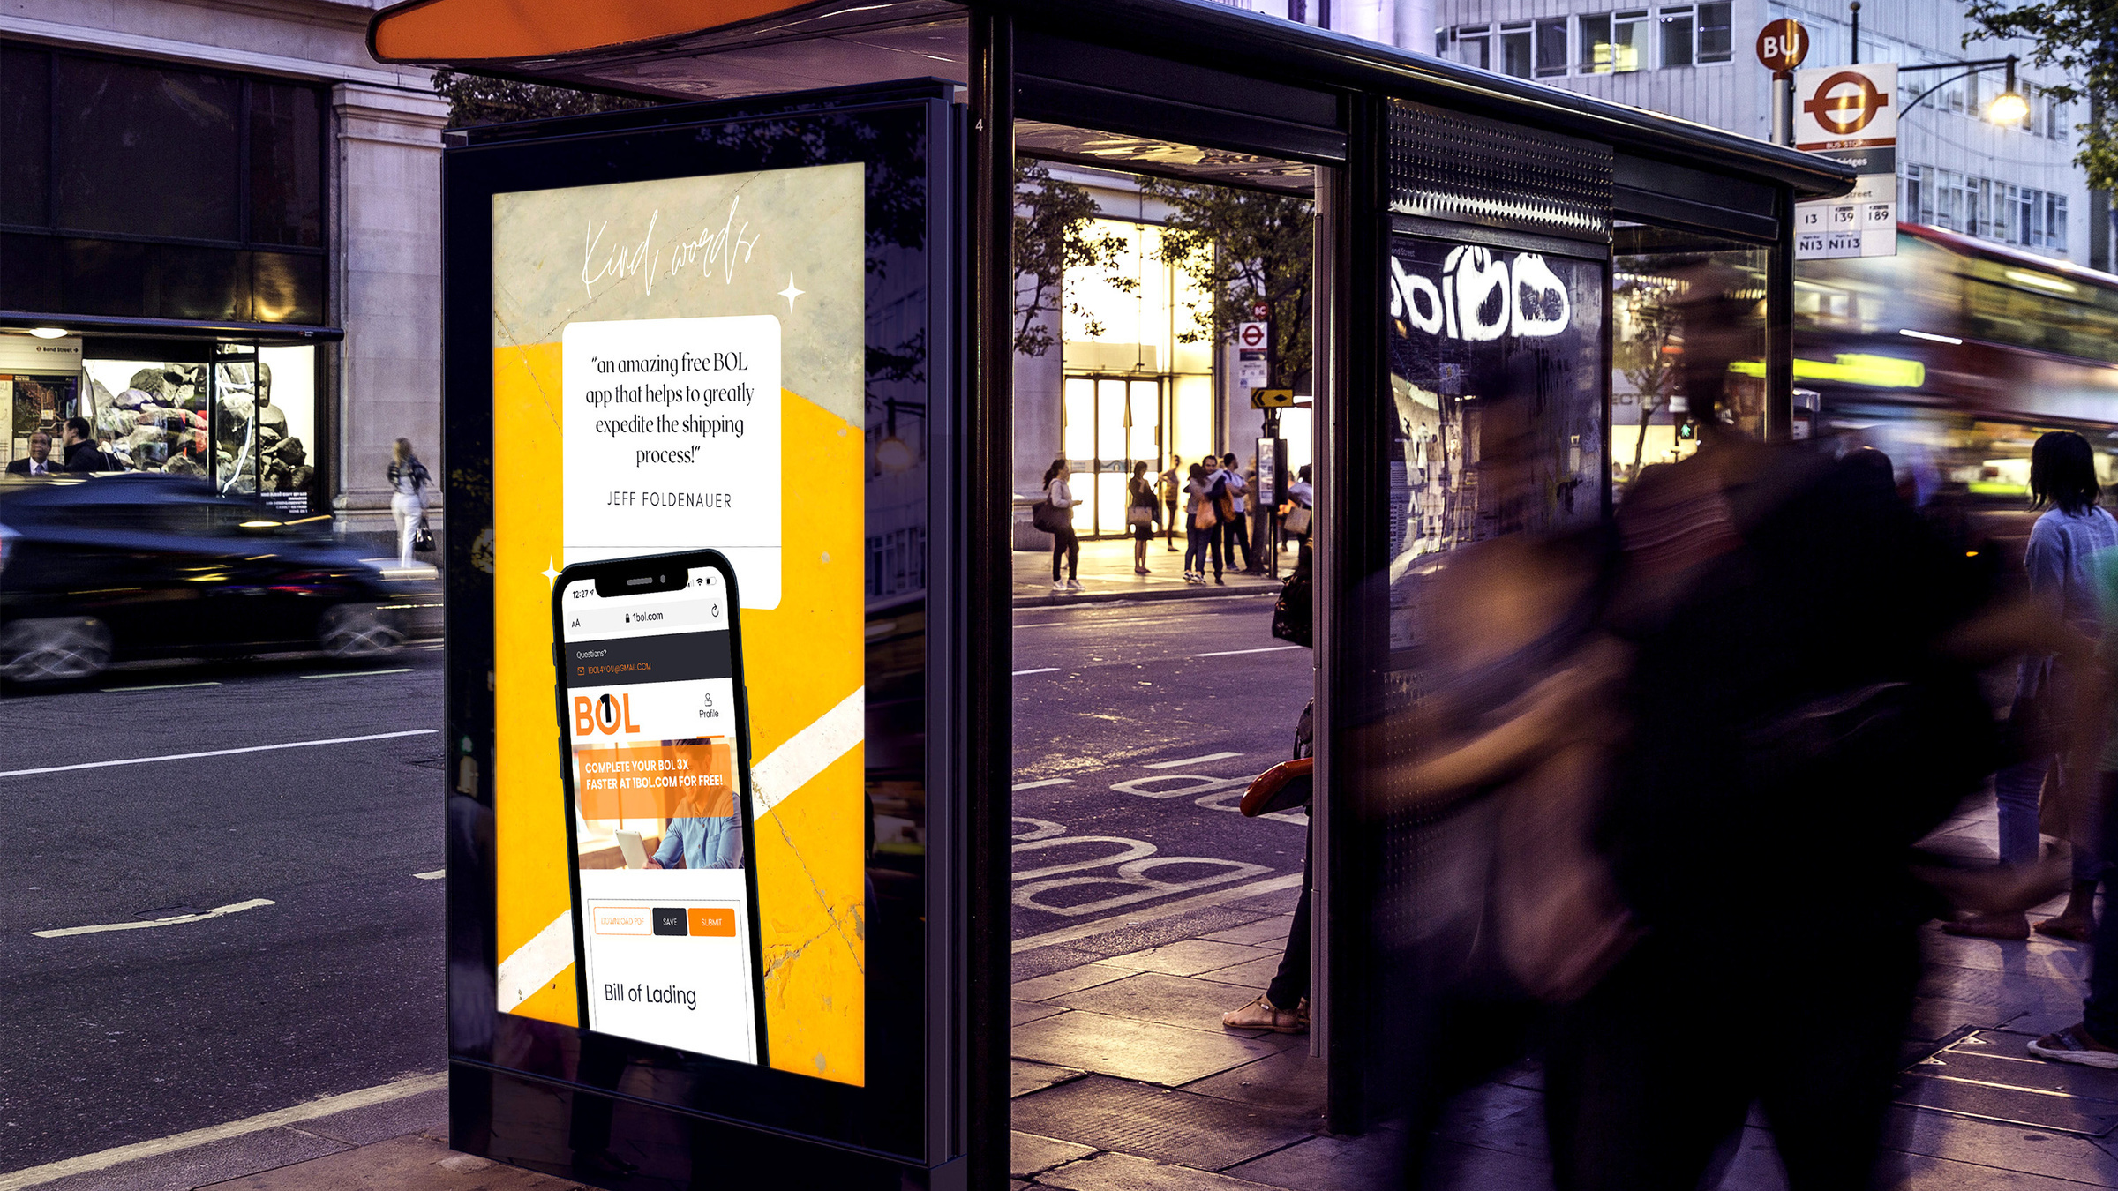



Marketing
MARKETING DISCIPLINES
B2B | B2C
Content
Digital
Email
Event|Tradeshow
Experiential
Influencer
Partner
Promotional
Search Engine (SEM)
Social
Traditional
Video
Marketing is the life blood of your company. Marketing allows you to effectively engage with your customer by building and maintaining the reputation of your business. The implementation of an effective marketing strategy creates and ongoing relationship of trust and communication between your business and its customers, helps boost sales and keeps your company relevant in the eyes of consumers.
J. Andrew de Leon
Marketing Specialist

Slide 5
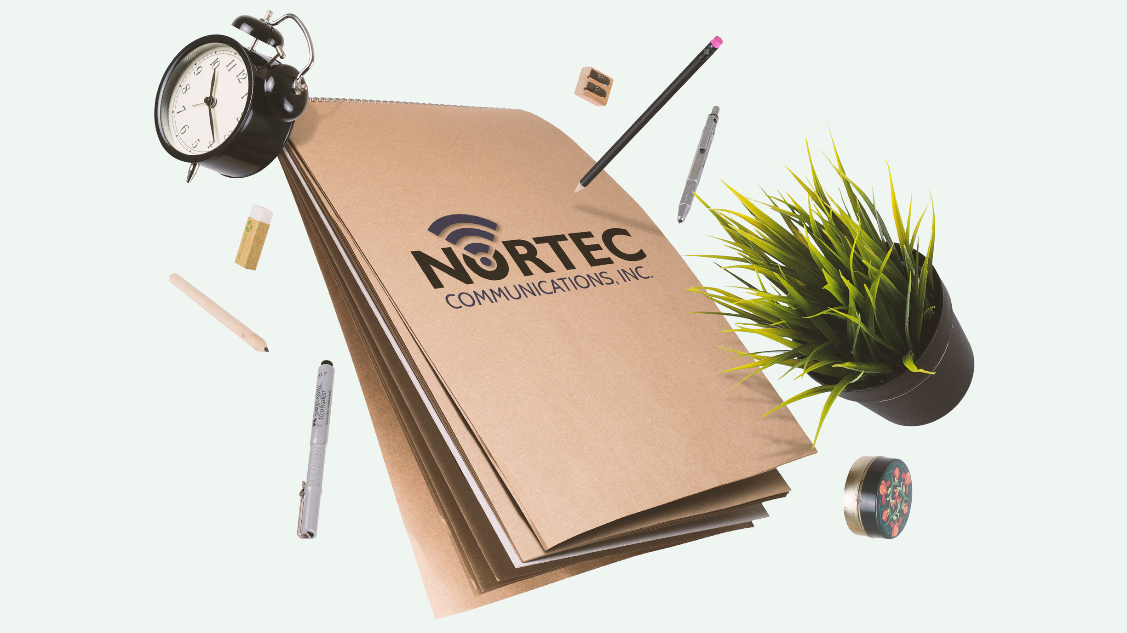
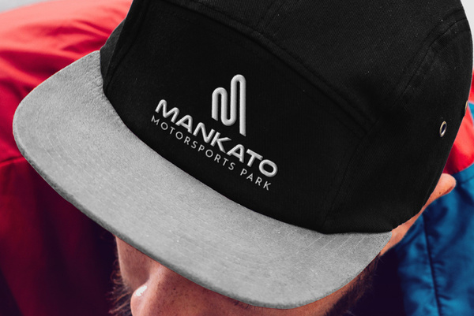
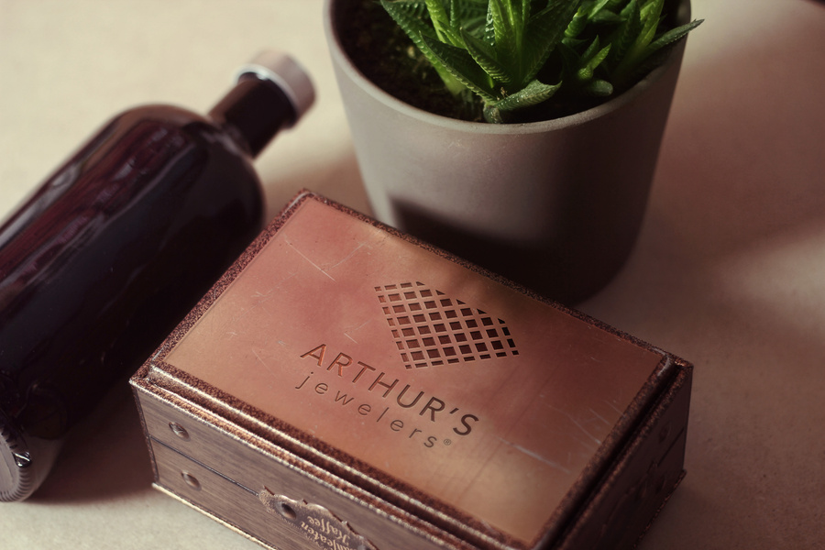



"Your brand makes a memorable impression on your customers and lets them know what to expect when they interact with your business."
Branding
Your brand is not just a visual representation of your business and staff, it is the touchstone that reflects the identity of your organization.
It symbolizes the story and impression you want portrayed and helps establish the legacy and reputation you have sought to create.
"As an expert in brand development and logo mark creation, I know how to play to the needs, desires and emotions of my clients' customers."
J. Andrew de Leon
Branding Specialist

Slide 6


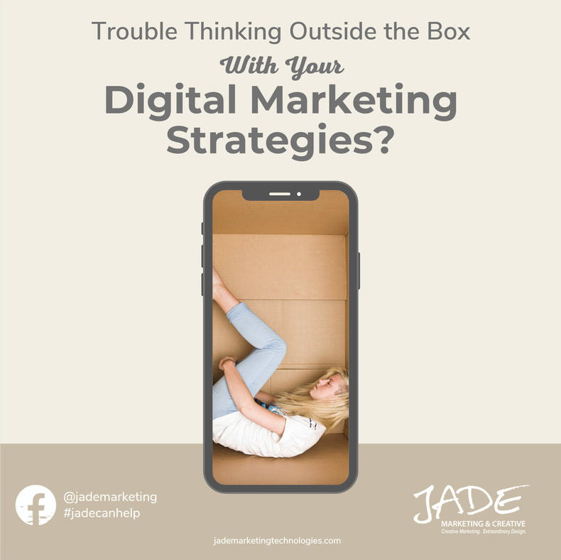

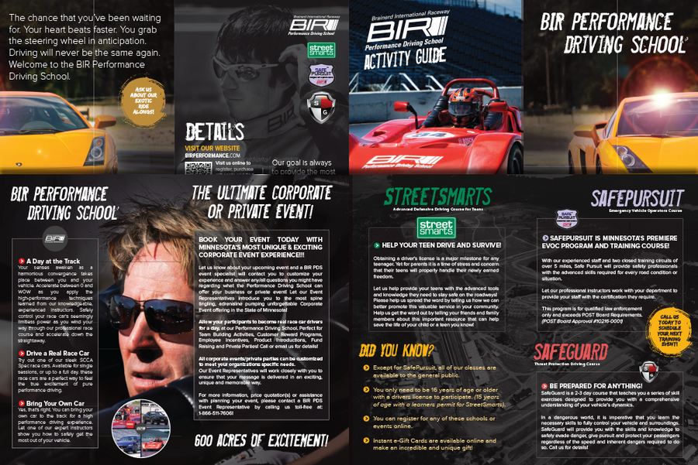
Creative Design
From marketing materials to digital artwork, from animation to signage, a creative design expert reflects the uniqueness of your messaging and the creativity of your organization.
With decades of design experience, I create appealing, innovative and professional content that engages in a memorable and at times humorous way with customers, prospects and employees.
J. Andrew de Leon
Creative Design Professional

Slide 7
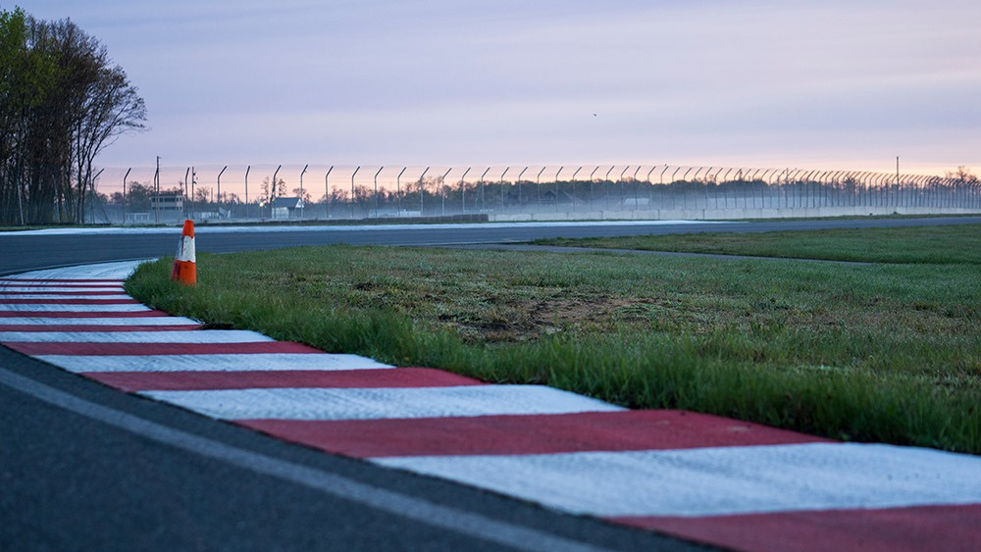

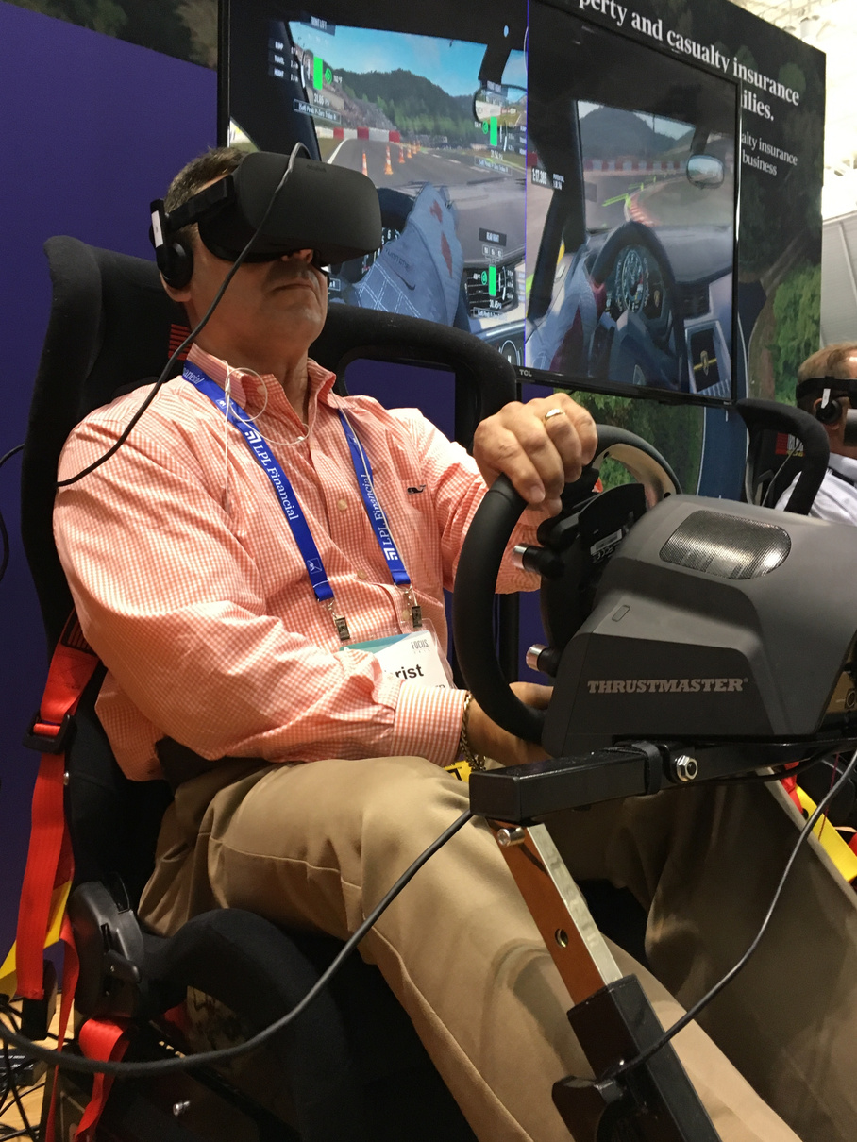
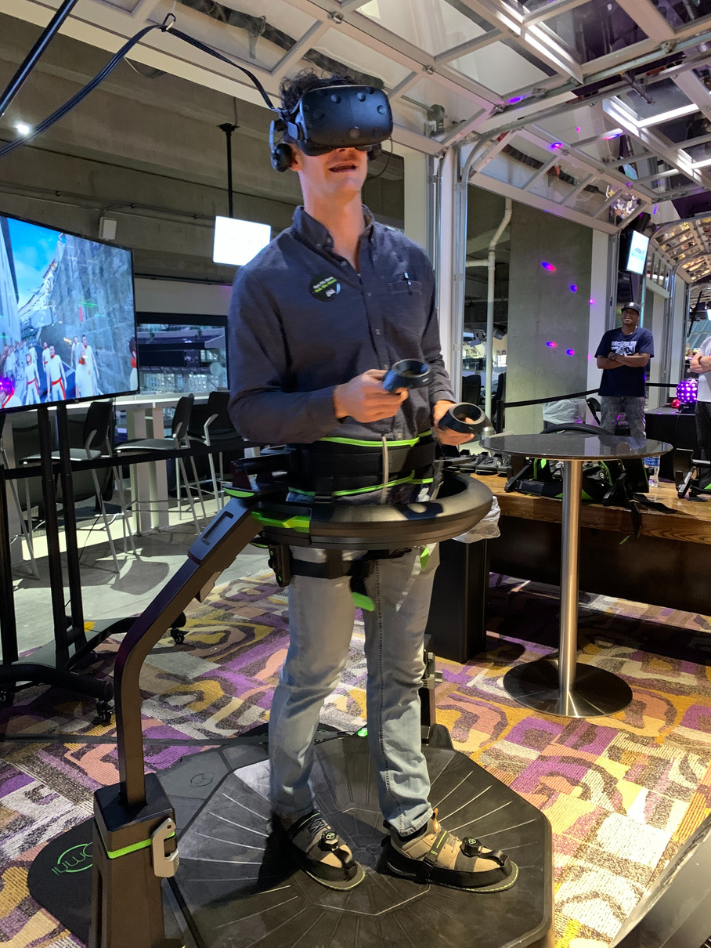
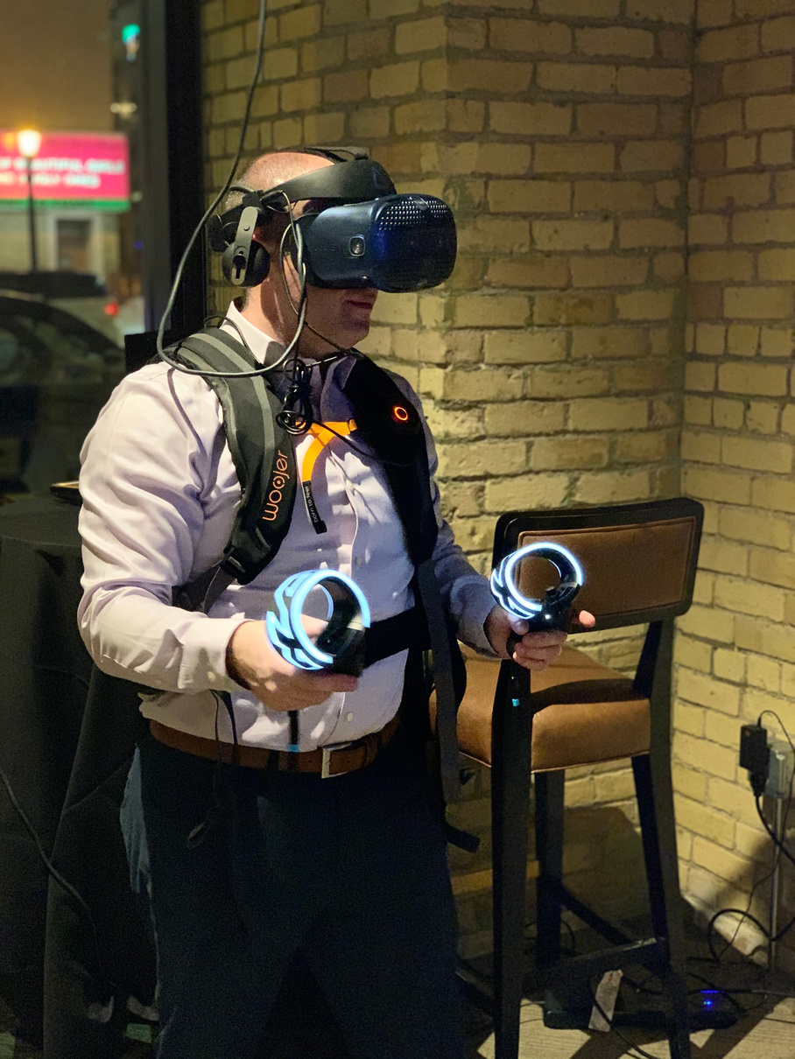
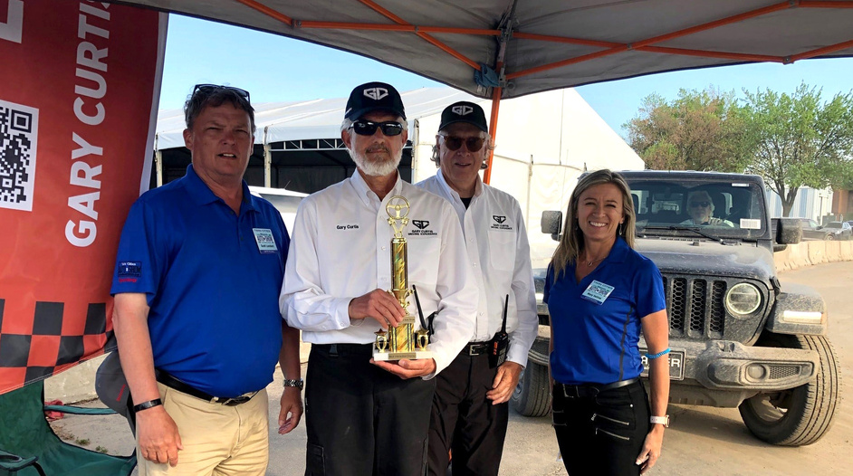

Event Management
Jade Marketing, along with its subsidiaries, has a long tradition of engaging customers and attendees with cutting edge technology including its innovative virtual reality events and lead capturing services.
From corporate and private events within the Twin Cities to tradeshows throughout the United States, my companies and I have consistently provided the best in event management and brand ambassadorship.
I have years of providing complete turn-key event management services for a range of different event types including 25 years in autosports marketing.
J. Andrew de Leon
Event Management Specialist

Slide 8

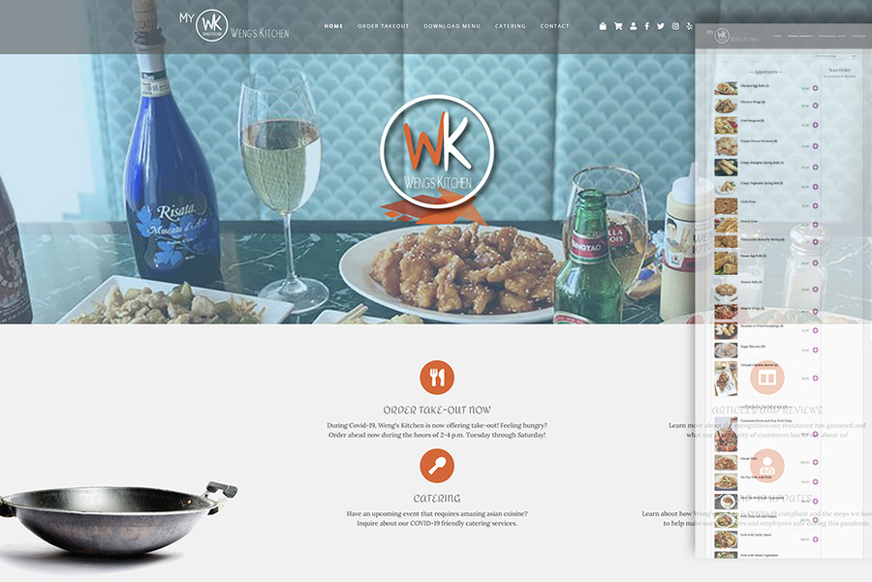
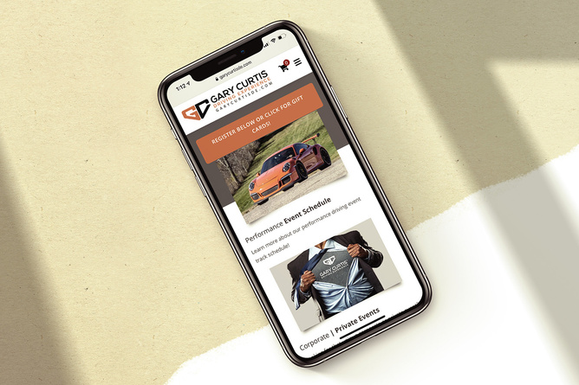
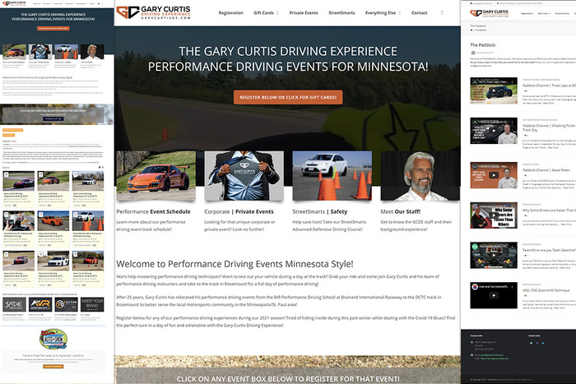
WordPress SEO|SEM
I provide comprehensive and advanced WordPress design and e-commerce development services to clients across the United States in a variety of different industries.
In addition to website design and development, I am experienced in onsite | offsite SEO techniques as well as SEM technologies and platforms designed to enhance site rankings on all major SERPs.
Your website is your virtual office space and is essential to your success as the center of any integrated digital marketing plan.
J. Andrew de Leon
WordPress Designer | Developer

Slide 9
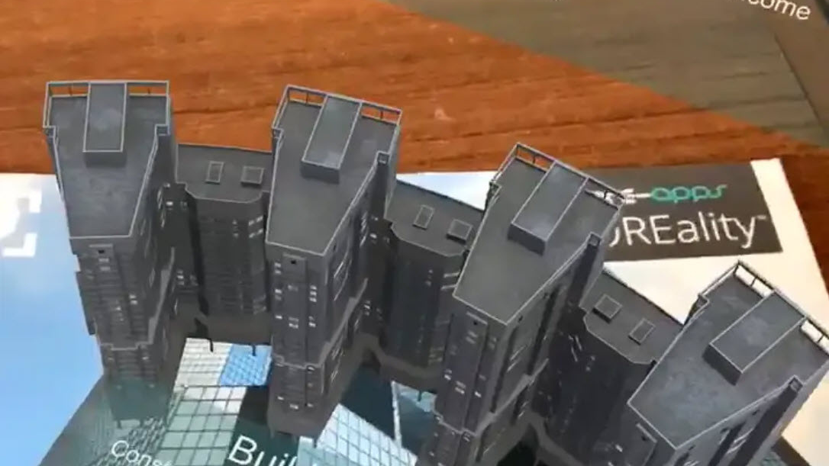
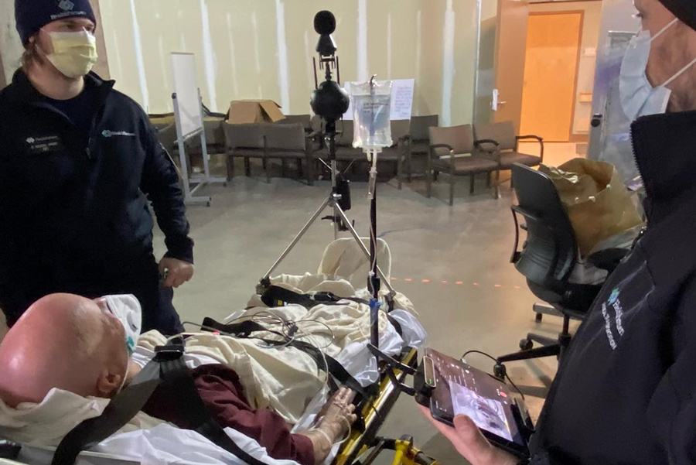
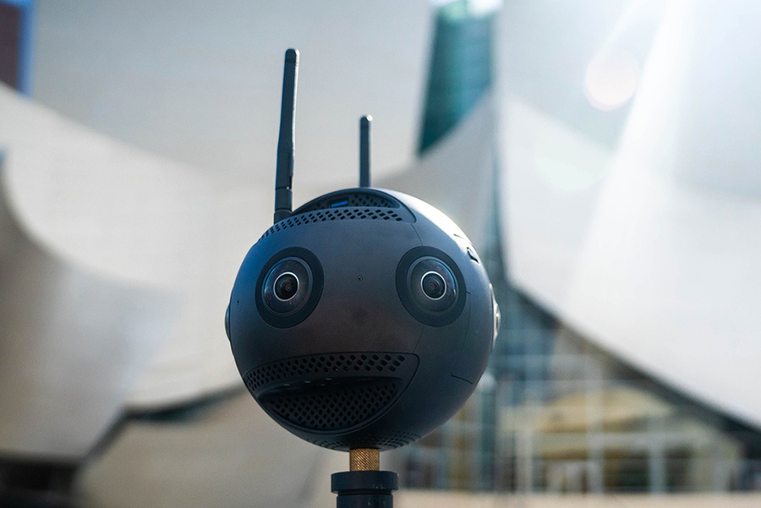
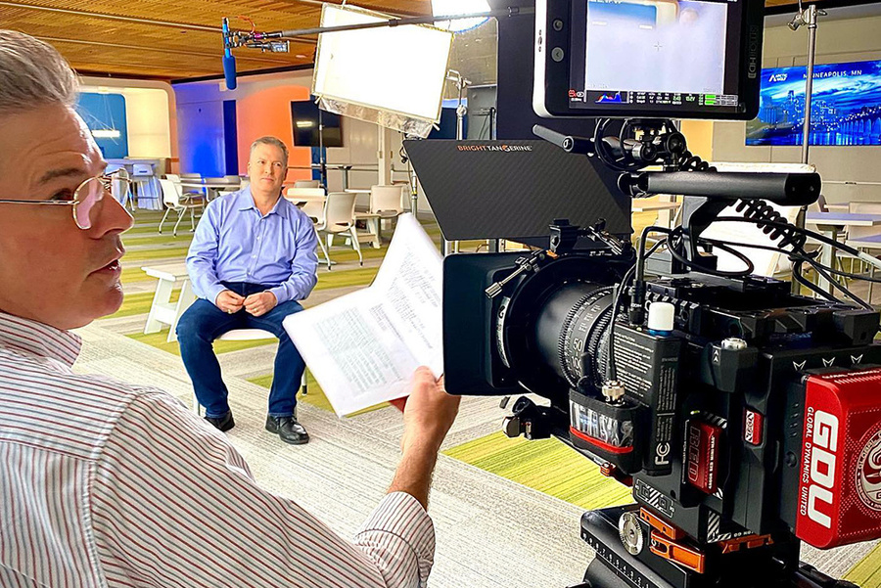


Media and Production
For decades, my companies have provided a full suite of professional media production services to my clients.
From traditional video, to virtual reality and augmented interactive productions, adding me to your team will allow your organization to have an expert in and access to the latest visual marketing technologies.
Take advantage of cutting edge production services to enhance your marketing efforts and stay ahead of your competitors.
J. Andrew de Leon
Technologist | Media Consultant

Slide 10
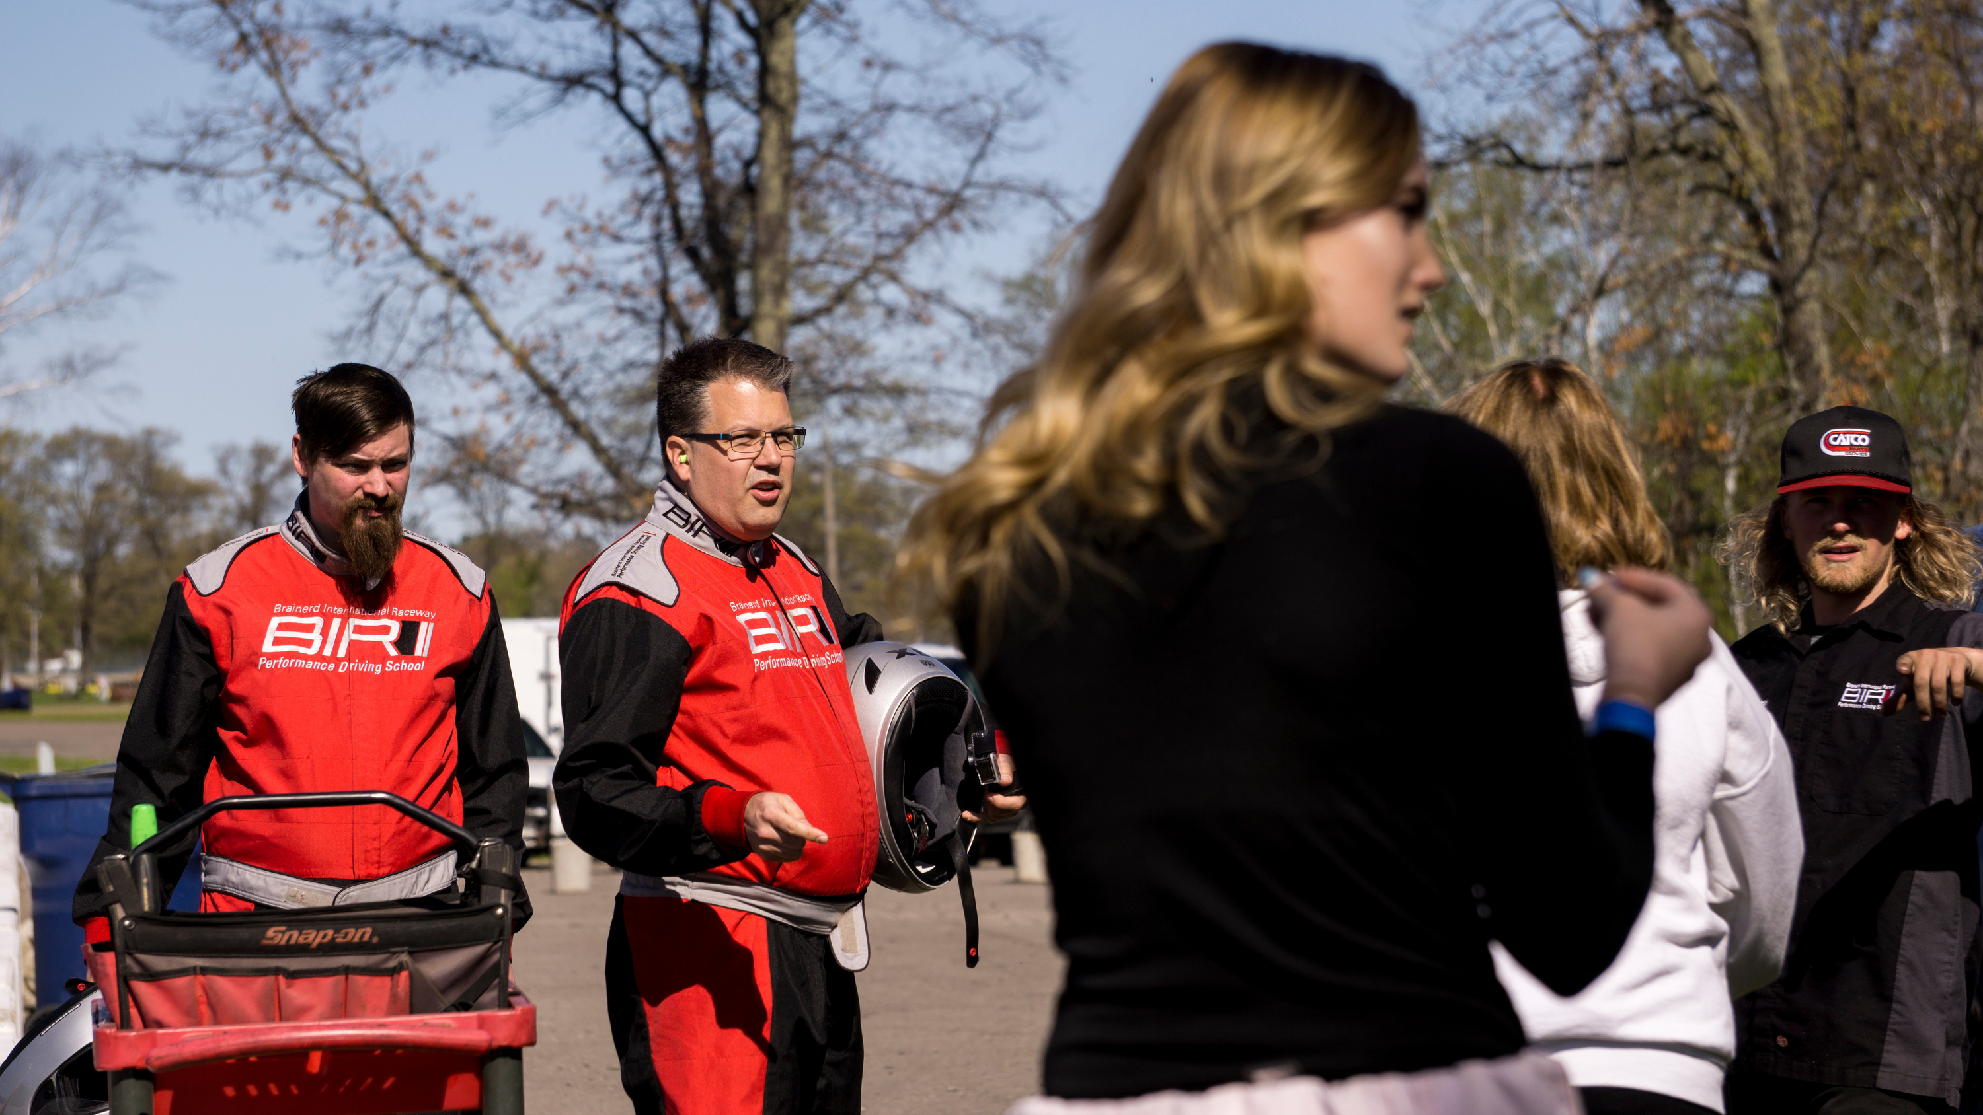
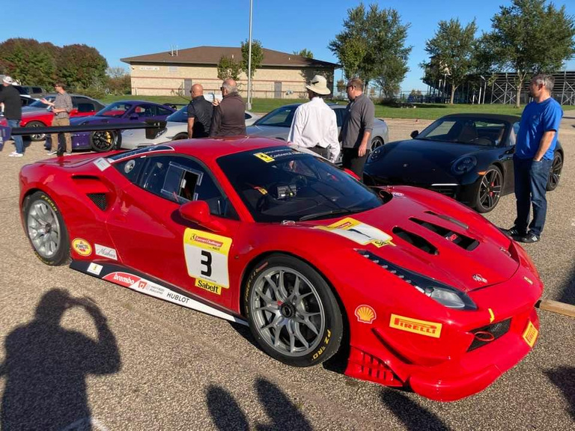
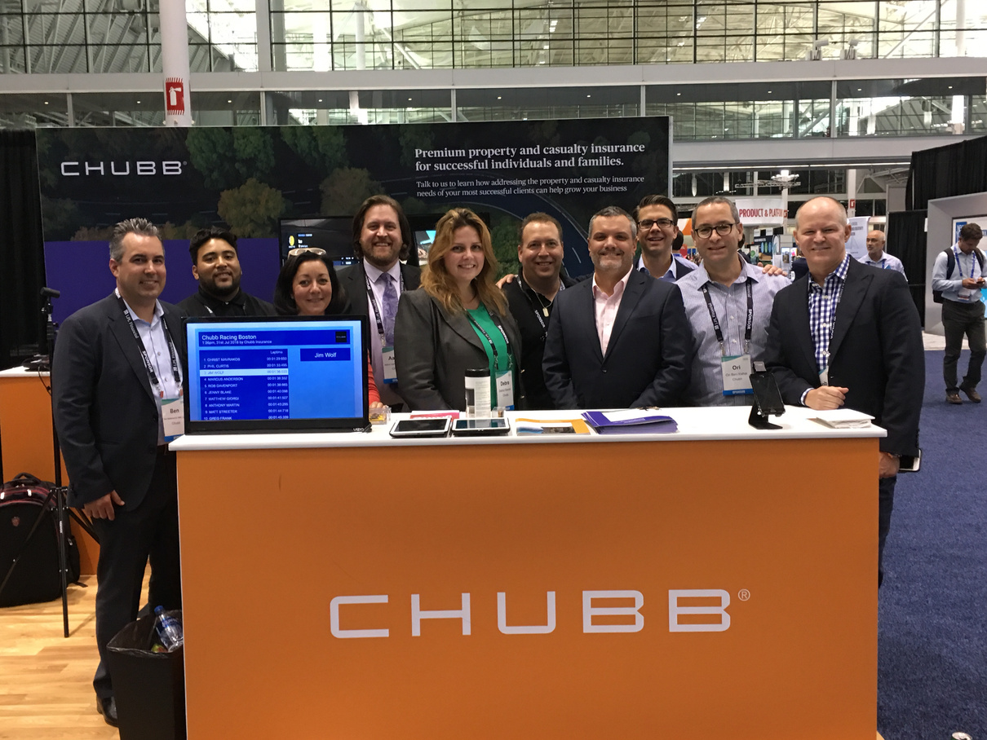
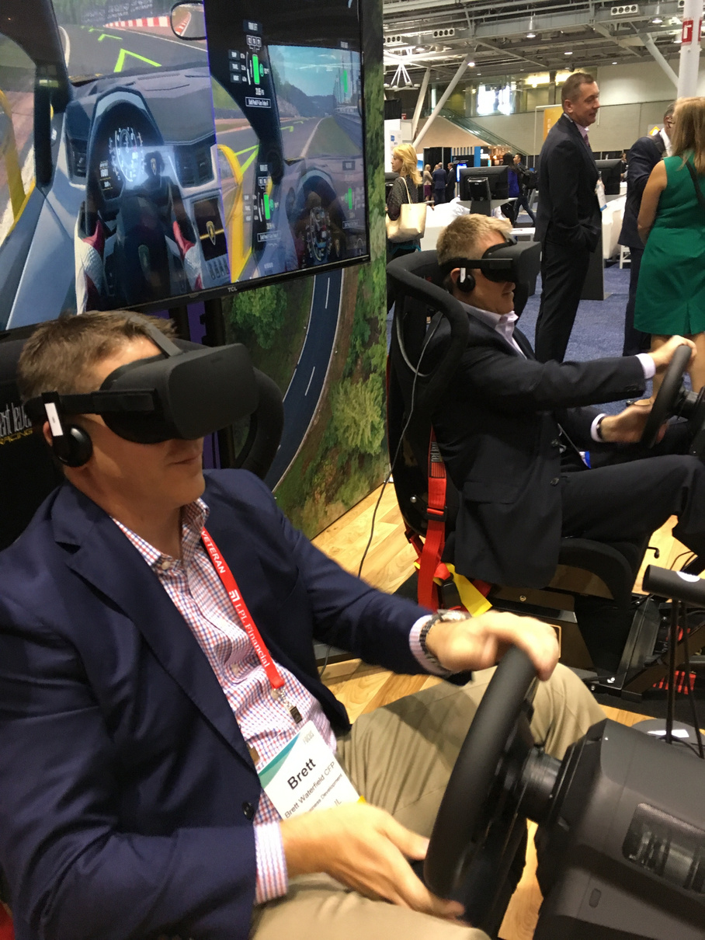
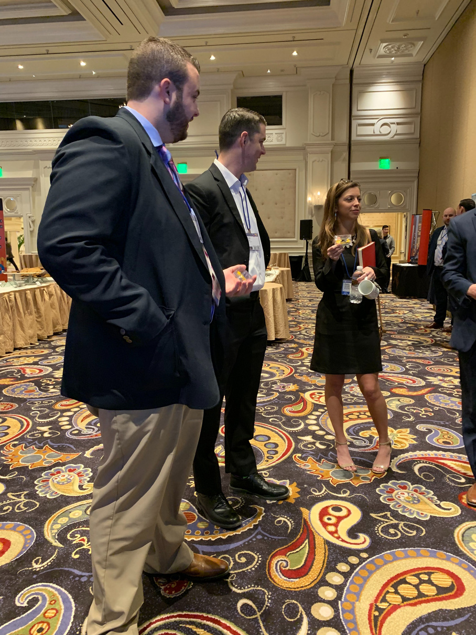
Team Management
Working towards goals while creating and maintaining a productive and engaged team of professionals is something that I have excelled in for over 30 years.
From event management to sales training, from marketing projects to comprehensive business solutions, my decades of business ownership and experience in a myriad of different marketing and creative disciplines has uniquely positioned me as a highly experienced leader and communicator.
J. Andrew de Leon
Management and Organizational Specialist

Slide 11
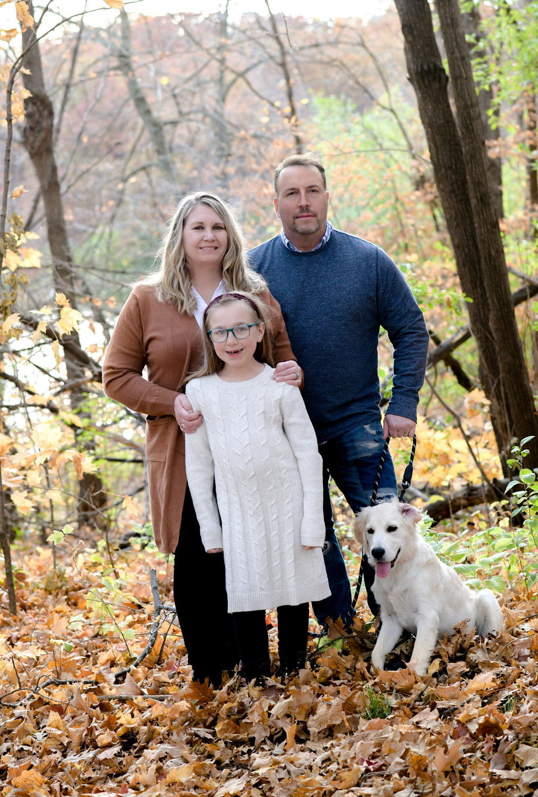
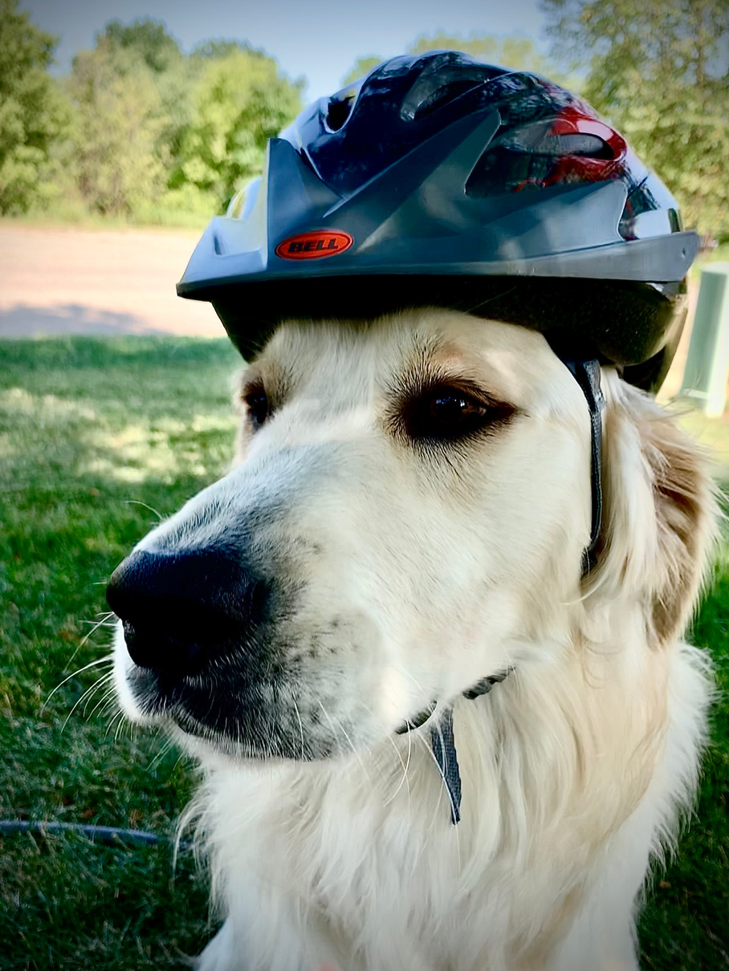
PERSONNEL CONTRACTORS, INC.
OWNER & CEO
Profile
Managed overall operations of publicly held, multi-state temporary job placement corporation with locations in MN, IL, AZ, FL and MD.
JADE MARKETING AND TECHNOLOGY CORP.
OWNER & CEO
GRADUATED CLASS OF 1986, EDINA HIGH SCHOOL
Manage overall operations and staff. Originally established as a web development agency, Jade Marketing has grown to a full service marketing
agency providing a wide range of promotional and marketing services to clients across the United States. Provided Autosports Marketing services to Brainerd International Raceway for 25 years.
St. Cloud State University
Lives in Lakeville, MN
Wife Kim, daughter Rylee and dog Scooter.
Hobbies include travel, golf, e-sports, culinary arts and technology.
ADVENTURES WITH VR
OWNER & CEO
Virtual reality event company offering the latest in high end virtual reality equipment and event services to private parties and corporate customers. Additionally, experiential marketing services, virtual reality filming, Matterport virtual tours, and Multiplex VR services.
J. Andrew de Leon

Slide 12
MOBILE | OFFICE
612.327.6426 | 952.388.1776
EMAIL ADDRESS
Let's Get Started!
jademarketingtechnology@gmail.com
ADDRESS
16421 Hillsboro Court, Lakeville, MN 55044
POPL
https://poplme.co/andrewdel
AVAILABILITY
By Hour
By Contract
By Remote Hire
By Monthly Retainer
Rates available upon request
WEBSITES
jademarketingtechnology.com, adventureswithvr.com, vectorsim.com
SOCIAL
FB: @JADEMARKETING, @ADVENTUREWITHVR @VECTORSIMRACING
@FREEMARKETINGTIPSBYJADE
J. Andrew de Leon

